Slide 1

Data Preparation/Exploration
Week 2
Semester 1, 2025
Dr. Farshid Keivanian

Slide 2
Unit Learning Outcomes
LO3 Apply data mining tools and techniques to generate human- interpretable patterns that describe the data (GA5, GA10)

Slide 3

What are we doing this week?
Data exploration
Data scrubbing
Solutions for handling missing and inconsistent data
Data and attribute reduction
Getting started with RapidMiner

Slide 4
Understanding Data Scrubbing: Fixing Errors in Data
Even when we try our best to collect data accurately, mistakes and errors can still happen. These mistakes can affect the quality of our analysis, so we need to clean the data before using it. This process is called data scrubbing, and it helps us handle different types of data issues, such as:
Missing data (blank or unknown values)
Inconsistent data (values that don’t make sense)
Reducing unnecessary data (removing extra records)
Removing unnecessary attributes (removing columns that are not useful)

Slide 5
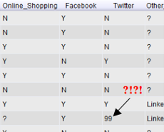
Understanding Data Scrubbing: Fixing Errors in Data
What is Inconsistent Data?
Inconsistent data means a value exists, but it is not correct or meaningful. It is different from missing data.
For example, in the image below, the Twitter column should only contain "Y" (Yes) or "N" (No). However, there is a "99", which does not make sense. This is an example of inconsistent data.
(Refer to the attached image)

Slide 6
Understanding Data Scrubbing: Fixing Errors in Data
How to Handle Missing Data?
Sometimes, we can replace missing values using Measures of Central Tendency, which help find typical values in the data:
Mean – The average of all values
Median – The middle value in a sorted list
Mode – The most common value
When replacing missing or inconsistent data, we should always use logic, common sense, and transparency to avoid introducing errors.

Slide 7
Understanding Data Scrubbing: Fixing Errors in Data
Preparing Data for Analysis
Before using data in a data science algorithm, we need to check for:
Outliers (values that are too high or too low)
Missing values (empty spaces in the dataset)
Highly correlated attributes (columns that are too similar)
Some machine learning algorithms do not work well when attributes are too similar, so we might need to remove them.

Slide 8
Understanding Data Scrubbing: Fixing Errors in Data
Key Takeaway
Cleaning and preparing data is an important step before any analysis. Whether we remove, replace, or modify data, we must always make sure the changes make sense for our project.

Slide 9
Understanding Data Scrubbing: Fixing Errors in Data
Problem-Solving Question:
Mean, Median, Mode Calculation
Problem: Given the numbers: 12, 15, 18, 21, 15, 16, 15, 17, × compute:
Mean
Median
Mode Which measure is the best choice for replacing a missing value in this dataset?

Slide 10
Understanding Data Scrubbing: Fixing Errors in Data
Solution:
Mean = (12 + 15 + 18 + 21 + 15 + 16 + 15 + 17) / 8 = 16.125
Median = Middle value in sorted data (15, 15, 15, 16, 17, 18, 21) → 15.5
Mode = Most frequent value → 15
What is the Best Choice?

Slide 11
Understanding Data Scrubbing: Fixing Errors in Data
The mode (15) appears most frequently in the dataset, making it a natural choice for replacing missing values.
The mean (16.125) could also work, but it might introduce a decimal value in a dataset where all values are whole numbers.
The median (15.5) is another reasonable option, but mode is typically preferred for missing value replacement when dealing with categorical or frequently occurring values.
Best Choice: Mode (15) because it represents the most common value in the dataset.

Slide 12
Understanding Data Scrubbing: Fixing Errors in Data
When Do We Choose Mean?
The mean is typically chosen when:
The data is symmetrically distributed without extreme values (outliers).
We want to represent the overall balance of the dataset.
The dataset contains continuous numerical data rather than categorical data.
However, if there are outliers (e.g., a very high or low number compared to the rest), the mean might not be the best choice, and the median could be more reliable.

Slide 13
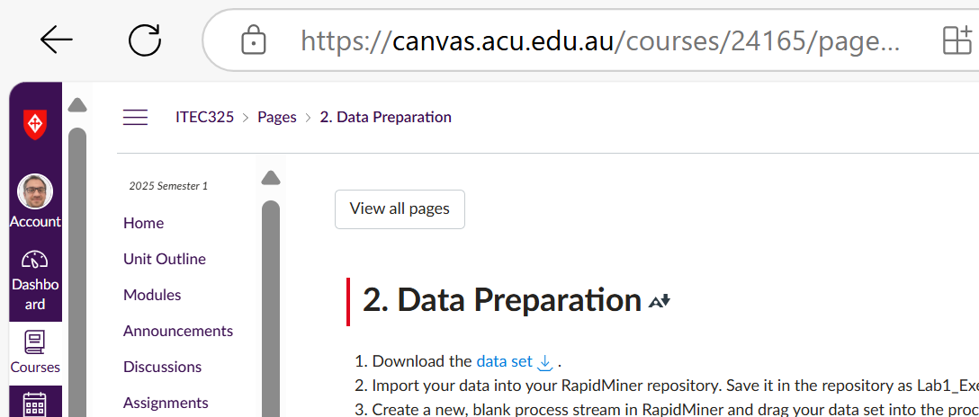
Data Preparation Using RapidMiner
Step 1: Download and Import the Data
Download the dataset and save it to your computer.
Import the dataset into RapidMiner and store it in your repository.
Rename the dataset in RapidMiner as Lab1_Exercise for easy reference.

Slide 14
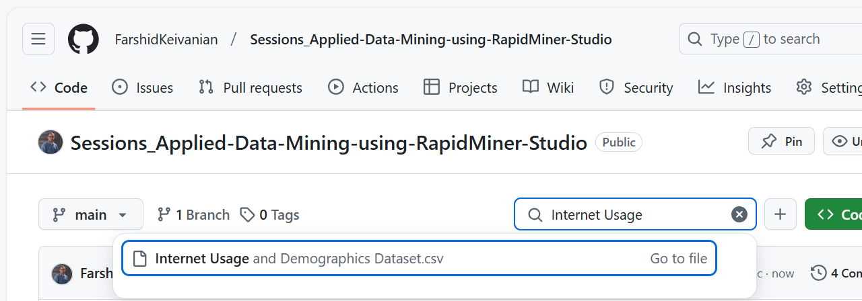
Data Preparation Using RapidMiner
“Internet Usage and Demographics Dataset", available on Github. It includes information about users' demographic details (gender, race, birth year, marital status) along with their internet habits (years on the internet, hours per day, preferred browser, search engine, email service, and social media usage).

Slide 15
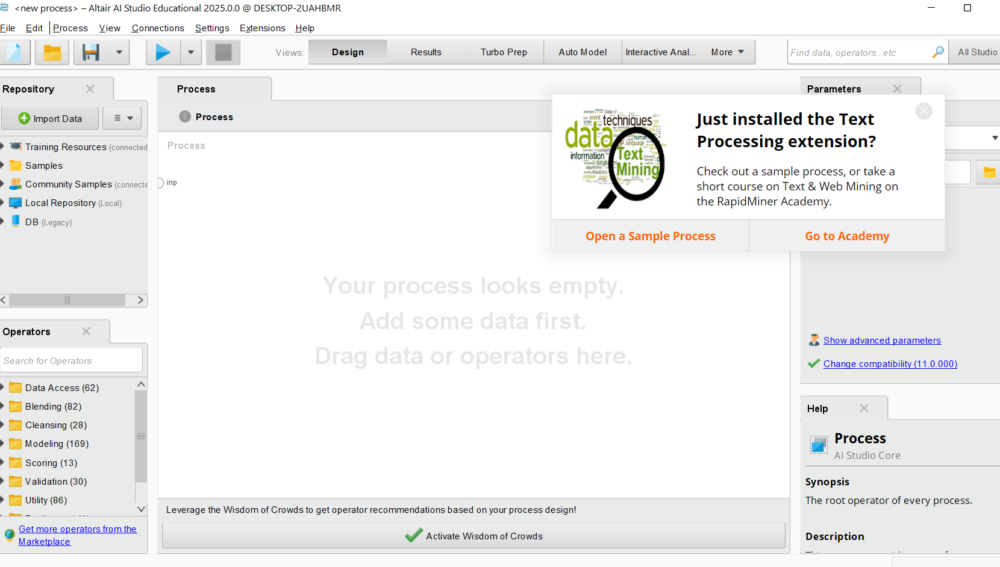
Data Preparation Using RapidMiner

Slide 16
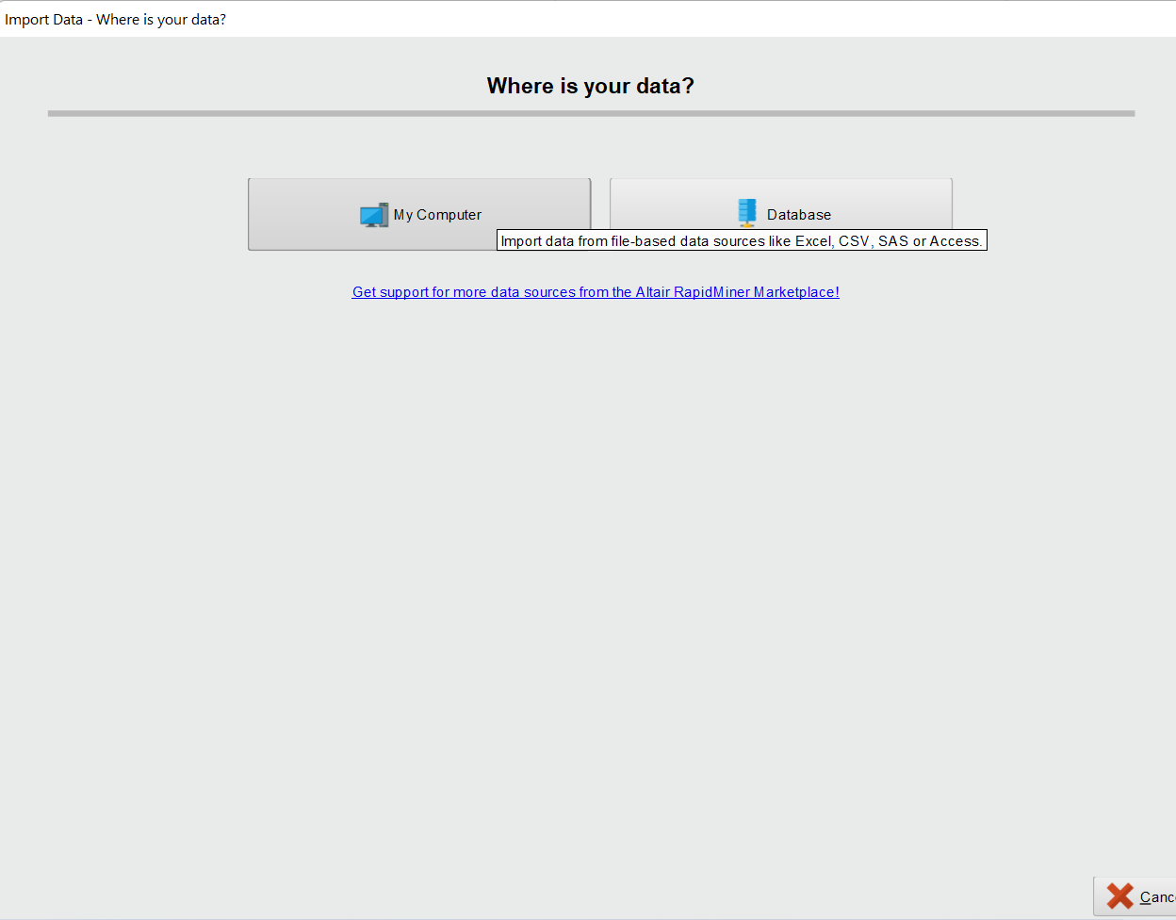
Data Preparation Using RapidMiner

Slide 17
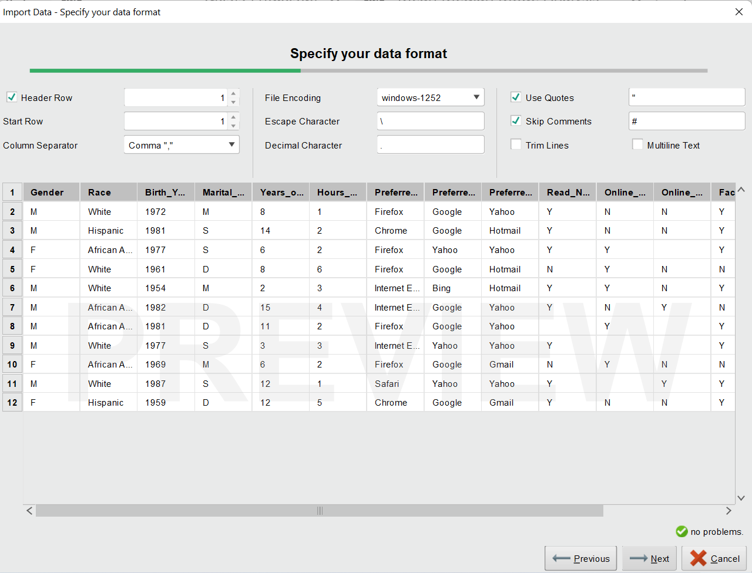
Data Preparation Using RapidMiner

Slide 18
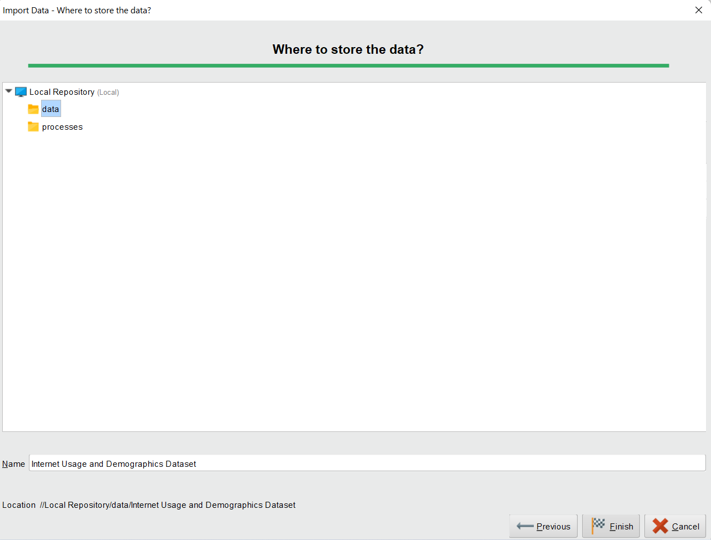
Data Preparation Using RapidMiner

Slide 19
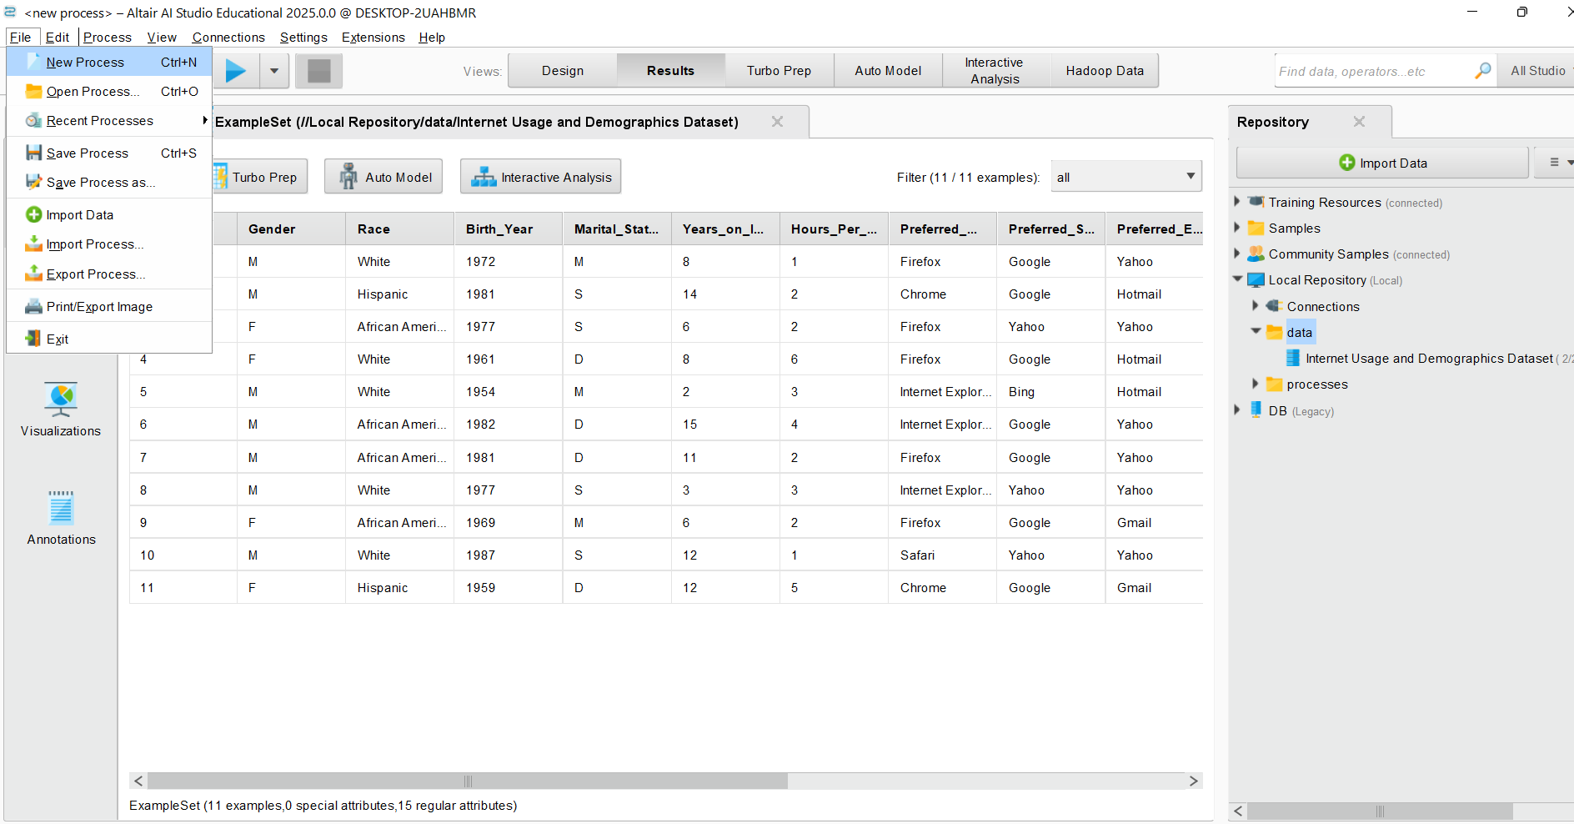
Data Preparation Using RapidMiner
Step 2: Set Up a New Process
1. Create a New Process
Open RapidMiner Studio.
Click File → New Process to create a new process.

Slide 20
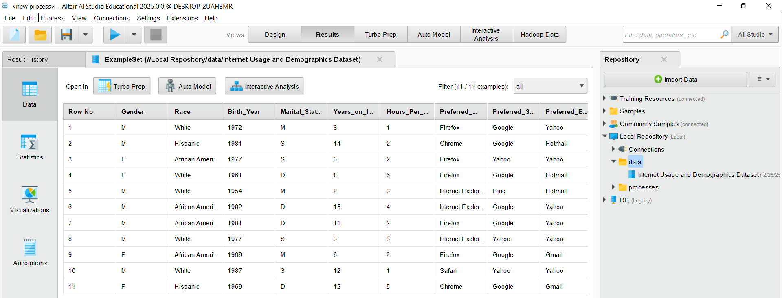
Data Preparation Using RapidMiner
Step 2: Set Up a New Process
2. Add the Dataset
In the Repository panel (usually on the left side), find your dataset (Lab1_Exercise if you renamed it) (I renamed it as Internet Usage and Demographics Dataset).
Double Click on it or Drag and drop the dataset into the Process window.

Slide 21
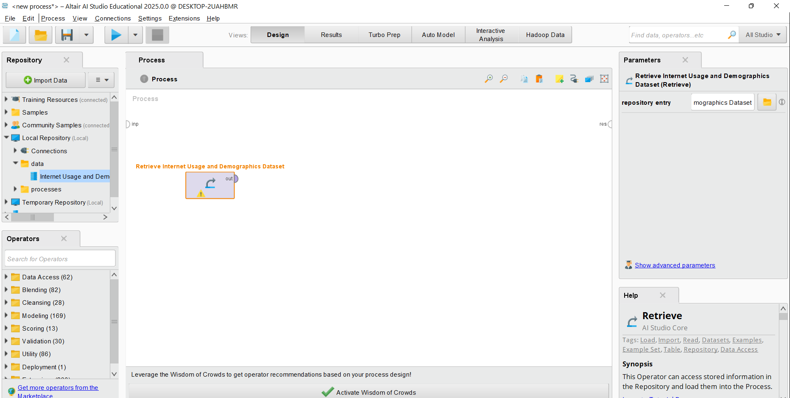
Step 2: Set Up a New Process
2. Add the Dataset
Click on Design, then in the Repository panel, usually on the left side, find your dataset (Lab1_Exercise if you renamed it as a standard name) (I renamed it as “Internet Usage and Demographics Dataset”).
Double Click on it or Drag and drop the dataset into the Process window.

Slide 22
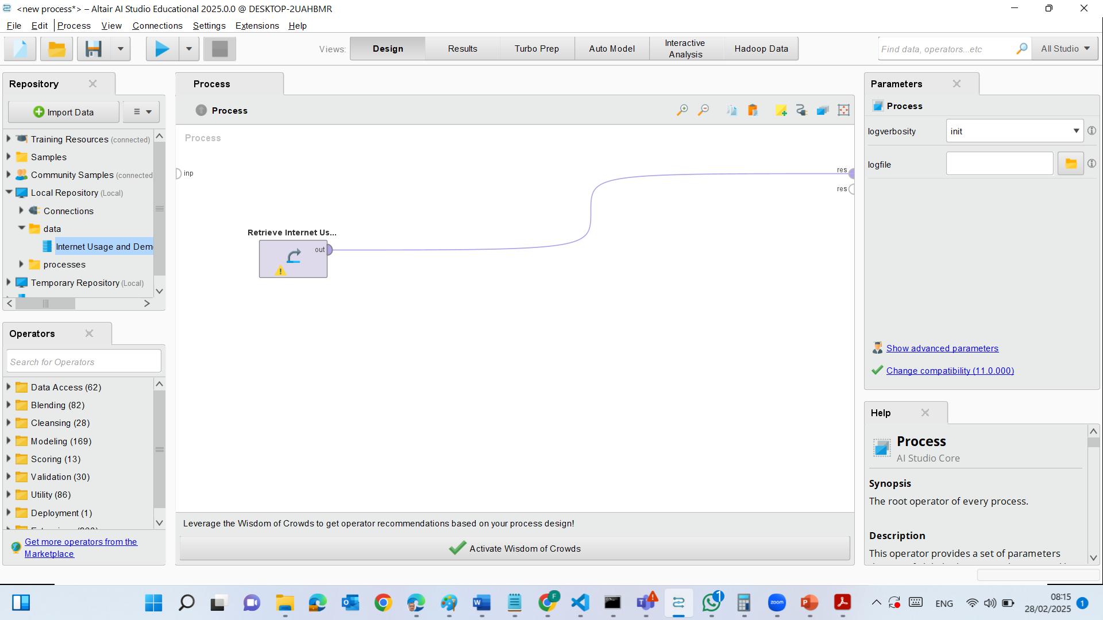
Step 2: Set Up a New Process
3. Connect Operators
When you drag the dataset, it automatically creates a Retrieve Operator.
Locate the Result port (res) at the right side of the Retrieve operator.
Drag a connection (spline) from the Retrieve operator’s output to the res (result) output.

Slide 23
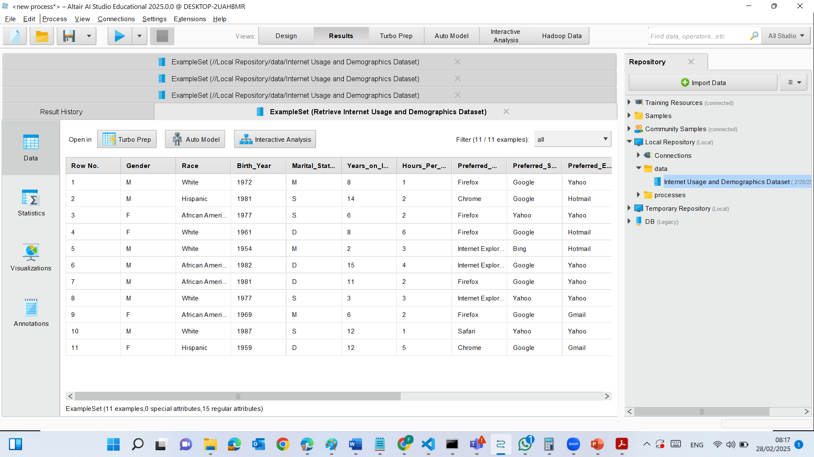
Step 2: Set Up a New Process
4. Run the Process
Click Run (blue play button at the top).
After running, check:
Results View: This shows column names, data types, and attribute statistics.
Data View: Displays actual records in a table format.

Slide 24
Step 2: Set Up a New Process
5. Identify Issues
Look for:
Missing values (empty cells or "?" symbols).
Inconsistent data types (e.g., numbers stored as text).
Unexpected values (e.g., incorrect dates, duplicate entries, or 99 in Twitter column).

Slide 25
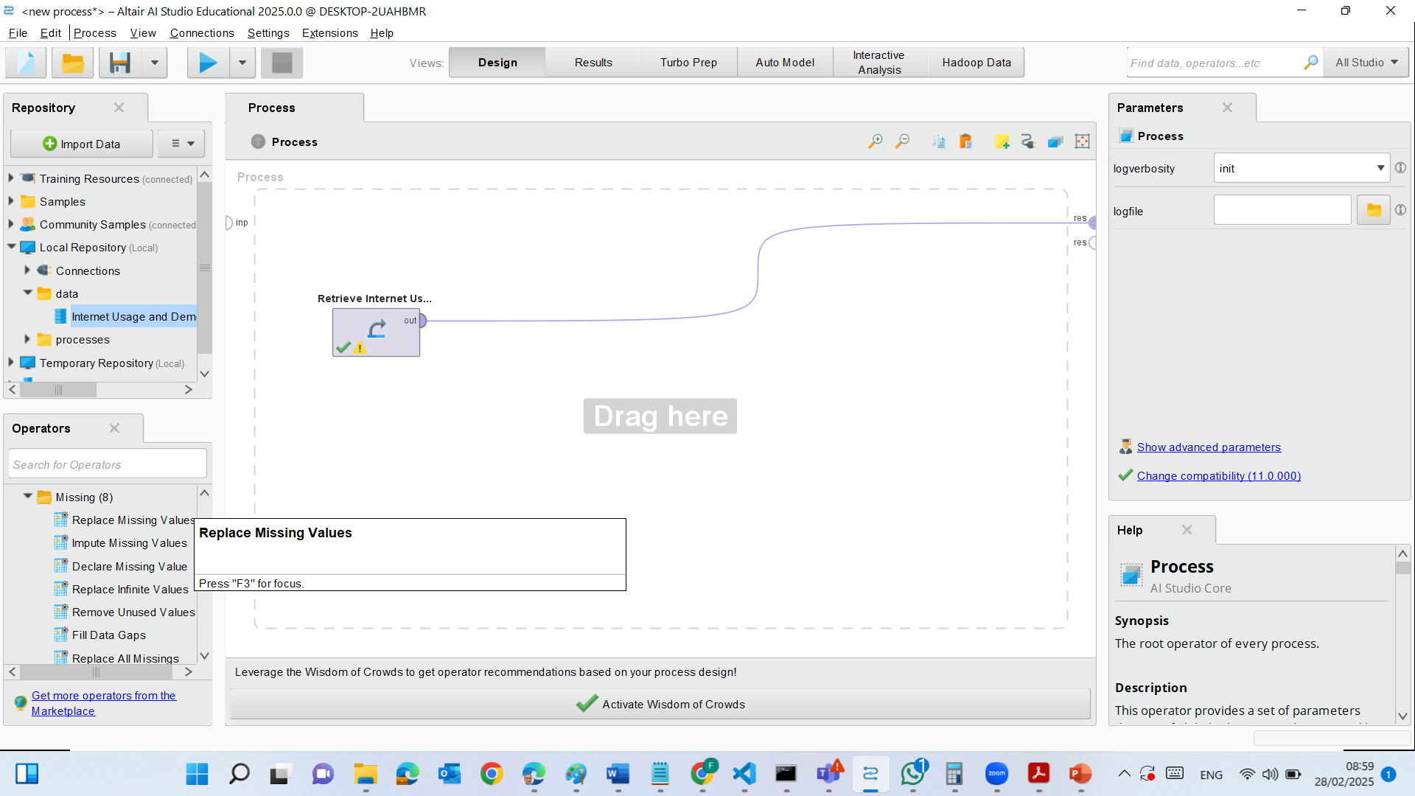
Step 3: Replace Missing Values in RapidMiner
In the Design View >> Find the "Replace Missing Values" operator in the Cleansing section under Operators.
Drag and drop the operator into your process window.
Connect the dataset's output (out) to the Replace Missing Values operator’s input port (exa).

Slide 26
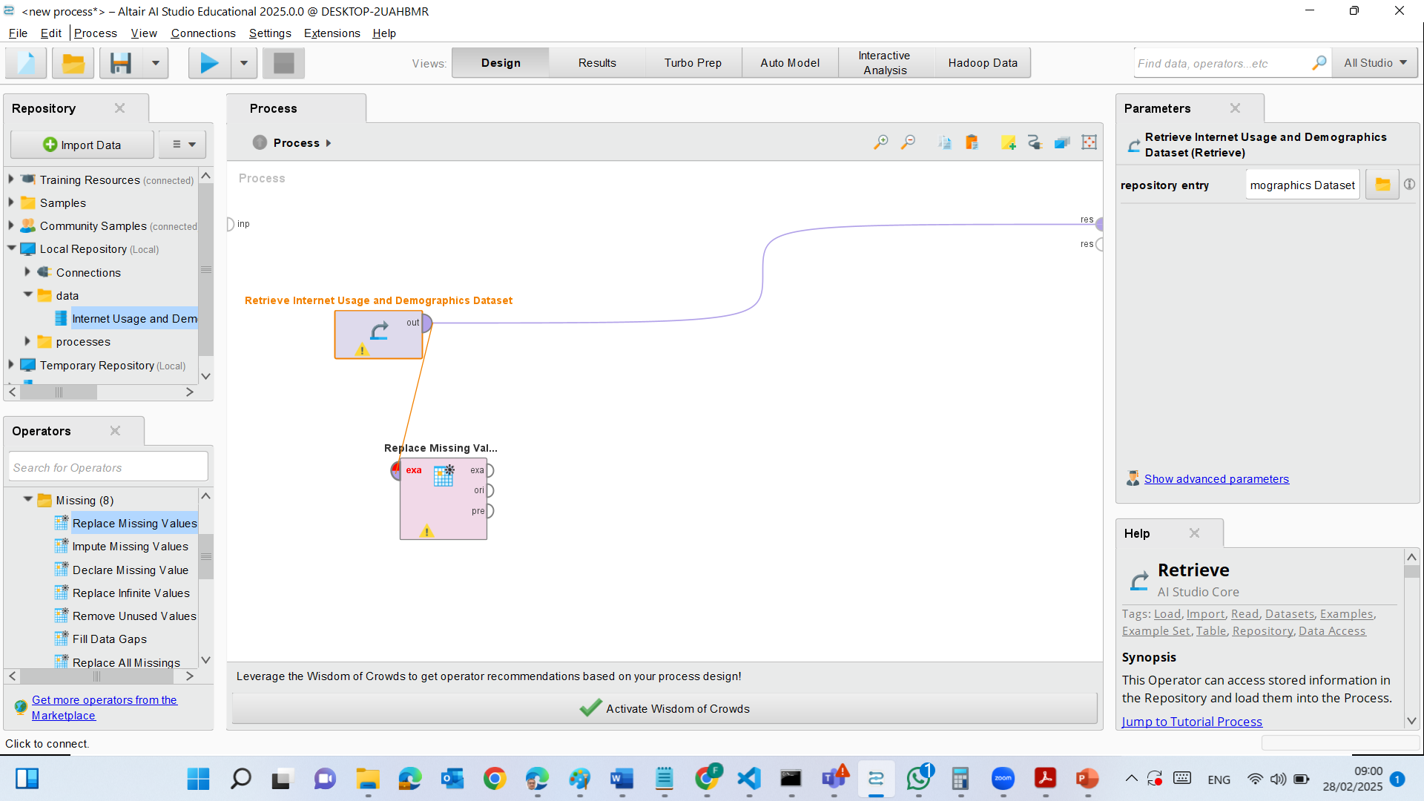
Step 3: Replace Missing Values in RapidMiner
In the Design View >> Find the "Replace Missing Values" operator in the Cleansing section under Operators.
Drag and drop the operator into your process window.
Connect the dataset's output (out) to the Replace Missing Values operator’s input port (exa).

Slide 27
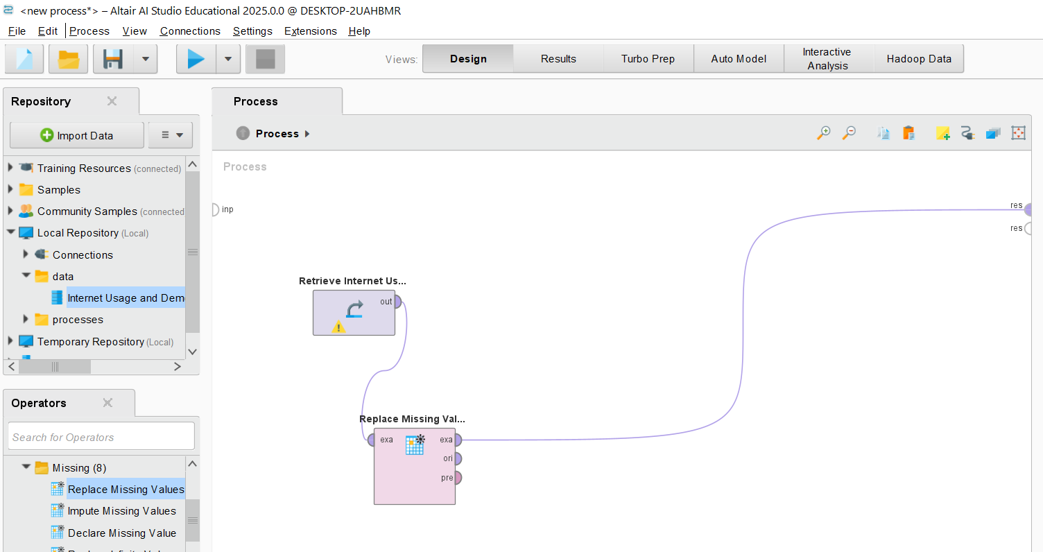
Step 3: Replace Missing Values in RapidMiner
Then, connect the Replace Missing Values "exa" output → to the Result (res) port.

Slide 28
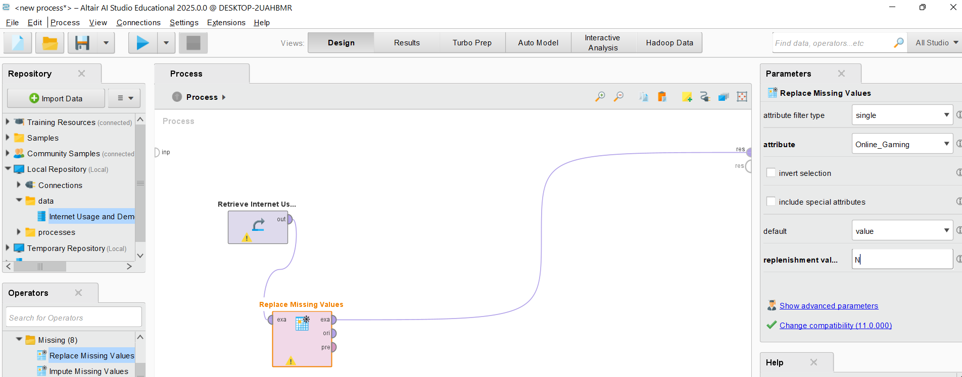
Step 3: Replace Missing Values in RapidMiner
Configure the Replacement Rule
Click on the Replace Missing Values operator to open its settings in the Parameters panel.
Set the following:
Attribute Filter Type: Single
Attribute: Online_Gaming
Default Replacement Value: N (Enter this manually)

Slide 29

Step 3: Replace Missing Values in RapidMiner
Verify the Setup
Check your process connections:
Retrieve → Replace Missing Values → Result (res)
Double-check that the Online_Gaming attribute is selected for replacement.

Slide 30
Step 4: Run and Check Results
Click the Run (▶️) button.
Once executed, go to the Results tab and check:
The Online_Gaming column should no longer have missing values (? symbols should be replaced with "N").

Slide 31
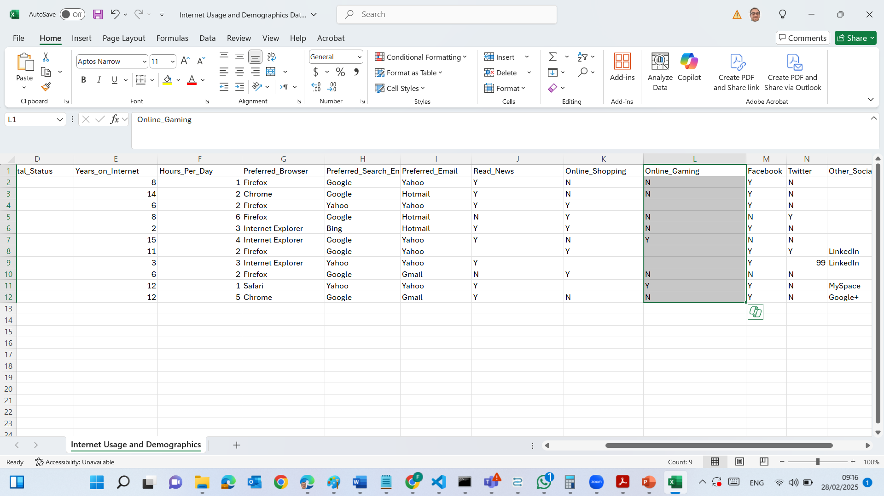
There was missing values in Online Gaming attribute. However, in the new results there is no missing value in this attribute.

Slide 32
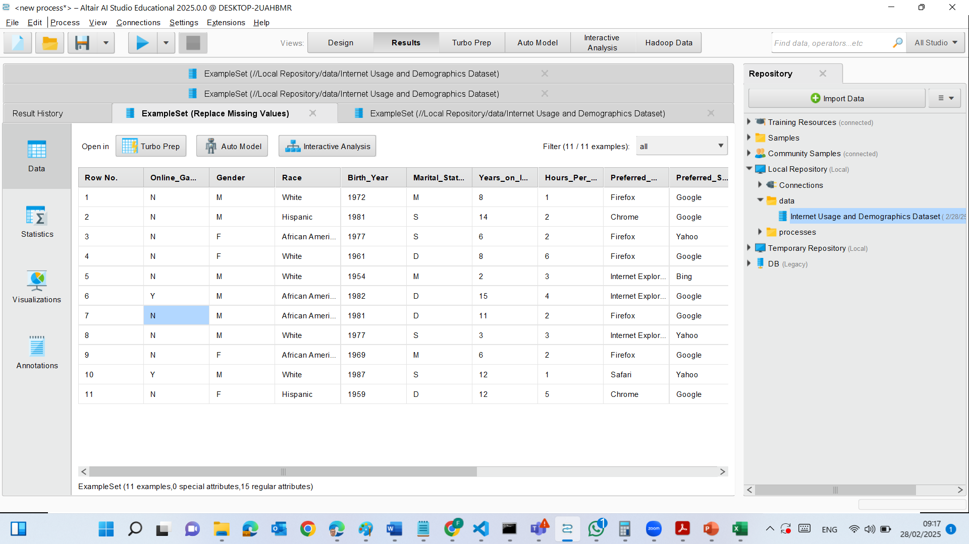
Replacing Missing Values for Online_Gaming:
The Replace Missing Values operator was applied to Online_Gaming.
Any missing value (?) in Online_Gaming was replaced with "N".
This ensures consistency in the dataset.

Slide 33
Online_Gaming column no longer has missing values.
Other columns still contain missing (?) and inconsistent values.

Slide 34
Step 5) Handling Other Missing Values
We still have missing values (?) in:
Online_Shopping
Other_Social_Network
Read_News

Slide 35
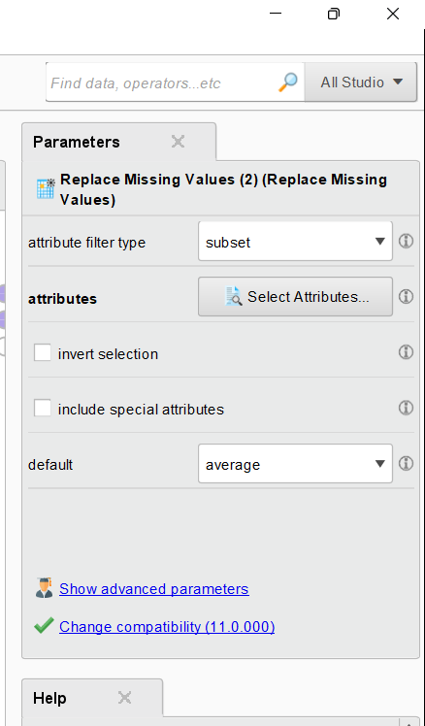
Step 5) Handling Other Missing Values
Configure the Operator:
Select Attribute Filter Type → Subset
Hold Ctrl key and Manually select Online_Gaming, Online_Shopping, Other_Social_Network, and Read_News.
Replace ? with "N".

Slide 36
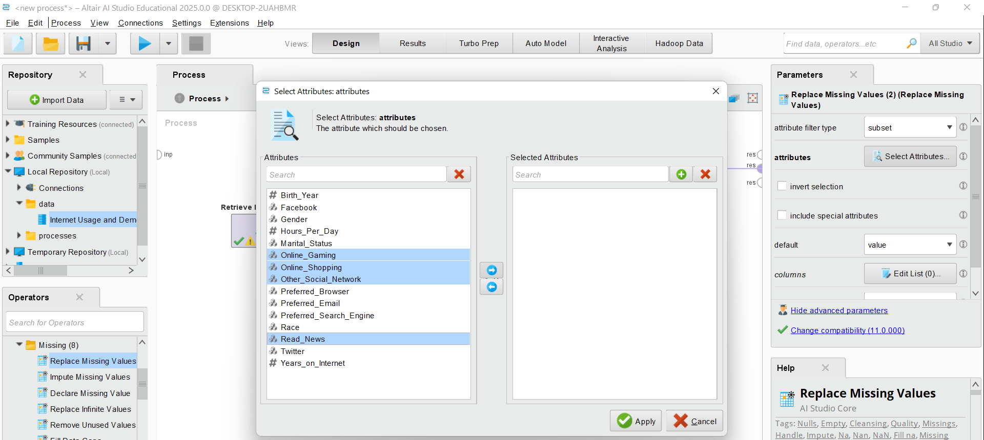
Step 5) Handling Other Missing Values
Configure the Operator:
Select Attribute Filter Type → Subset
Hold Ctrl key and Manually select Online_Gaming, Online_Shopping, Other_Social_Network, and Read_News.
Replace ? with "N".

Slide 37
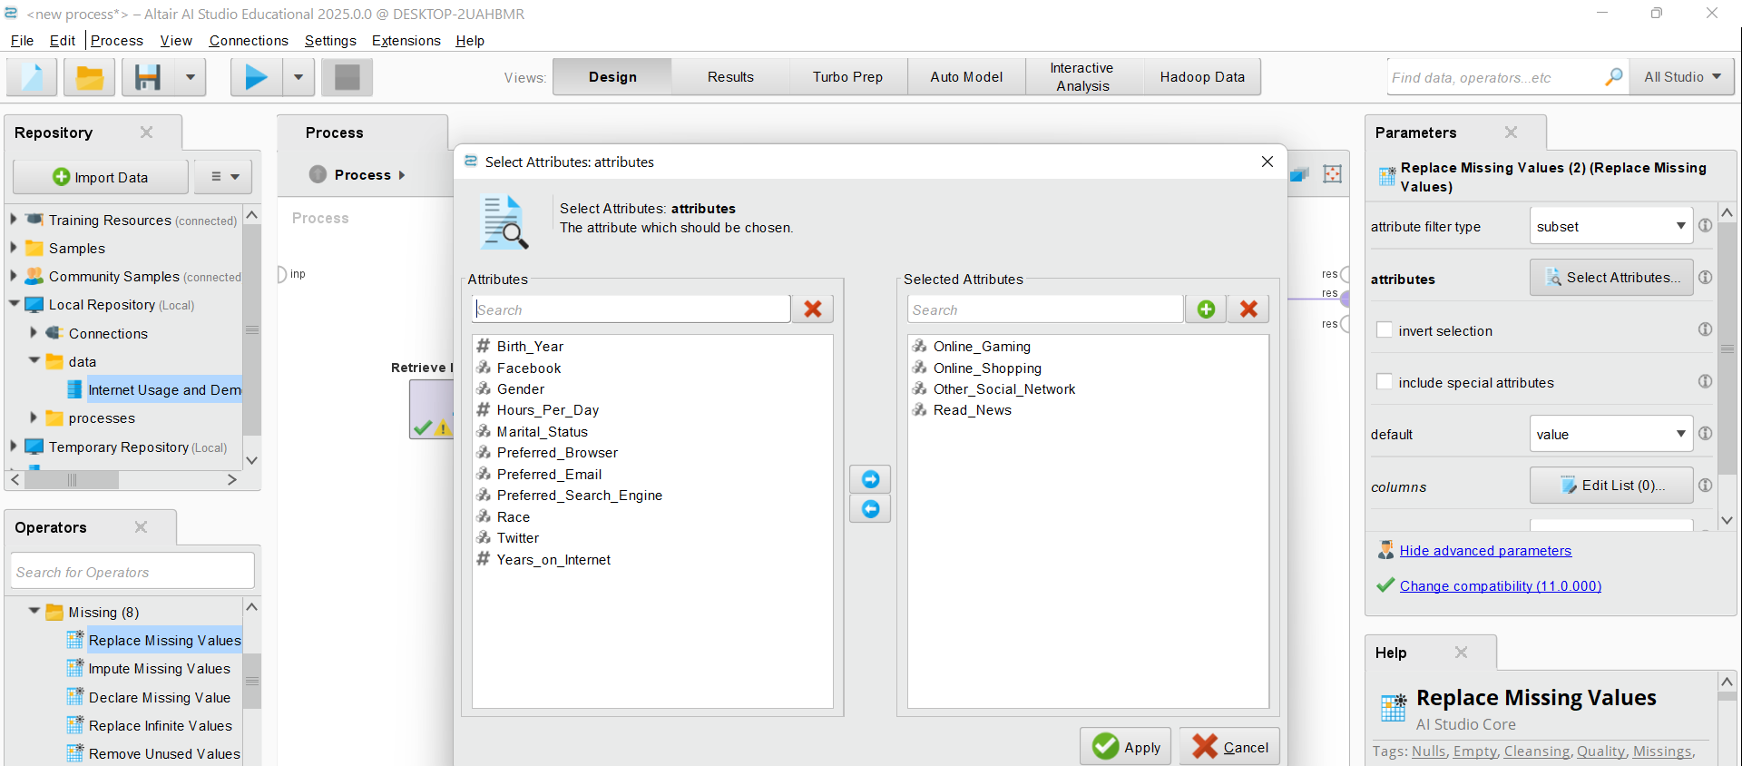
Configure the Operator:
Select Attribute Filter Type → Subset
Hold Ctrl key and Manually select Online_Gaming, Online_Shopping, Other_Social_Network, and Read_News.
Replace ? with "N".

Slide 38
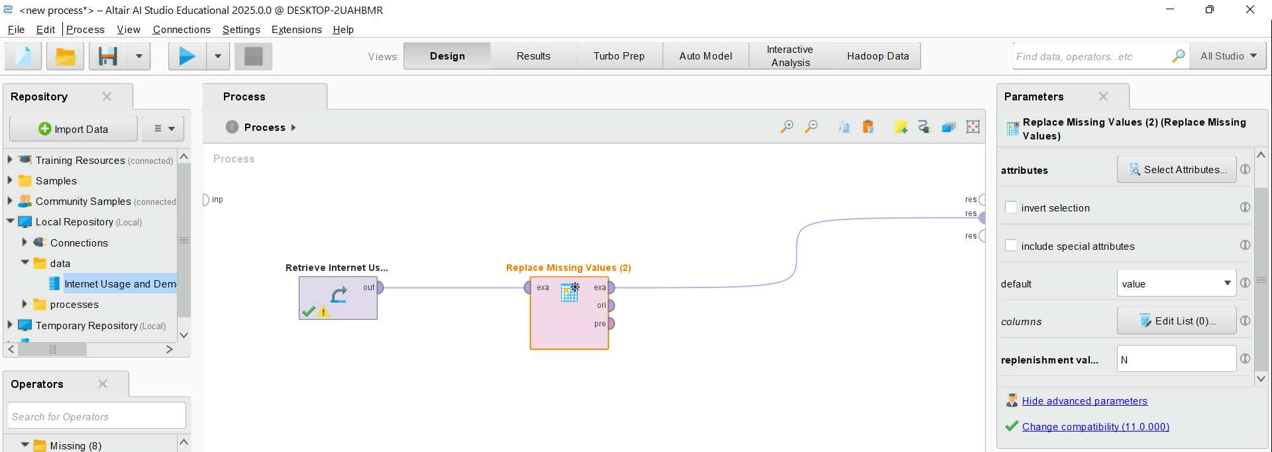
Step 5) Handling Other Missing Values
Configure the Operator:
Select Value for the Default
Type N as for the replenishment value to Replace “?” with "N".

Slide 39
Step 5) Handling Other Missing Values
Run and Check results

Slide 40
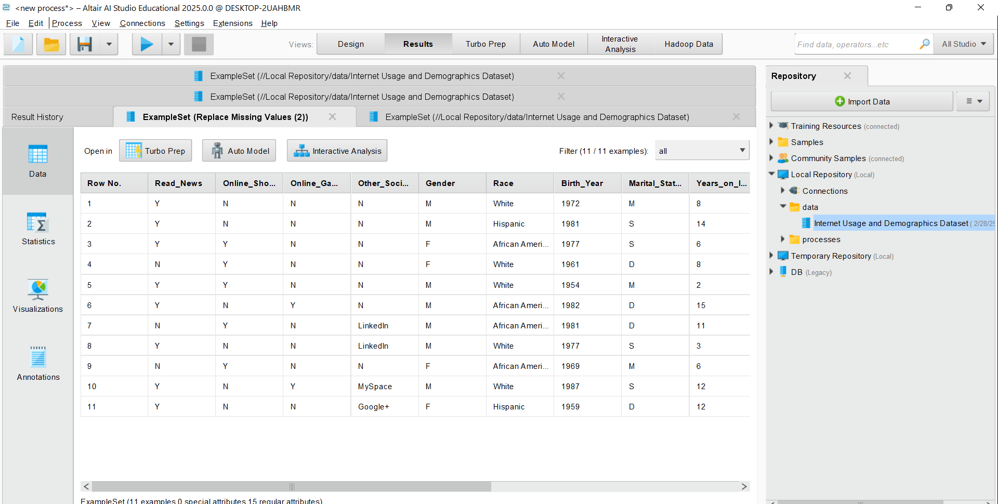
Step 5) Handling Other Missing Values
Run and Check results: There are no missing values!

Slide 41
Key Points to Remember
Missing values can affect analysis, so replacing them ensures cleaner data.
RapidMiner uses the term "ExampleSet" for data rows (observations).
Connecting operators correctly is important for the process to run smoothly.

Slide 42
Your files might also be saved in C:\Users\...\Documents\AltairRapidMiner\AI Studio\Local Repository\data

Slide 43
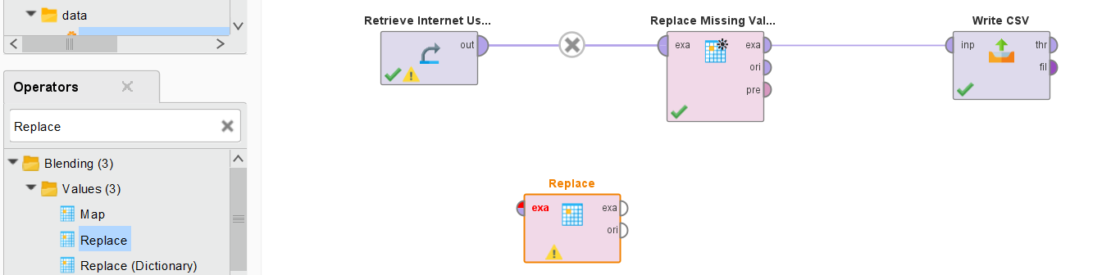
Step 6) Handling Inconsistent Data (e.g., Twitter = 99)
Step 6) Steps to Clean Inconsistent Data in RapidMiner
Locate the "Replace" Operator
In the Operators panel (left side), use the search bar and type Replace.
Expand the Values category under Blending.
Drag and drop the Replace operator into the Process window.

Slide 44
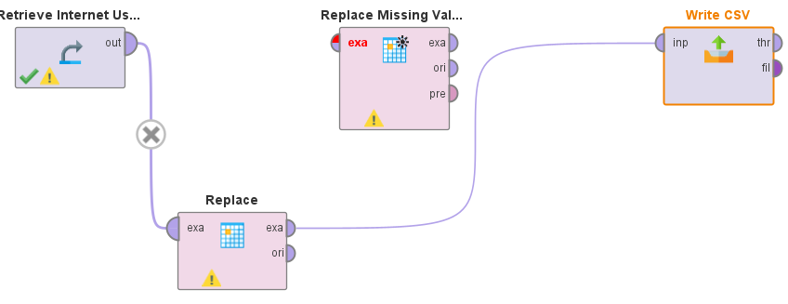
Step 6) Handling Inconsistent Data (e.g., Twitter = 99)
Connect the Replace Operator
Connect the output (out) of the Retrieve Internet Usage operator to the exa (input) of the Replace operator.
Connect the exa (output) of the Replace operator to the next step (e.g., Write CSV or Results).

Slide 45
Configure the Replace Operator
Click on the Replace operator.
In the Parameters panel on the right:
Select Attribute Filter Type: Choose Single.
Choose the Column: Select the column where you want to replace values (e.g., "Twitter").
Find What: Enter 99 (or any inconsistent value that needs replacement).
Replace With: Enter "N" (or another appropriate standardized value).
Enable Regular Expression only if using patterns to find values.

Slide 46
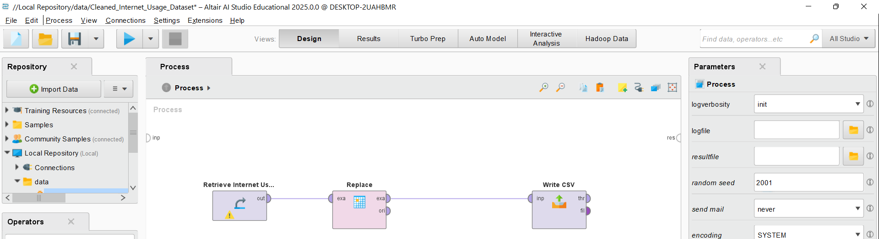
Run the Process
Click the Run (▶️) button at the top.
Once the process completes, go to the Results tab.
Verify that all 99 values in the Twitter column are replaced with "N".

Slide 47
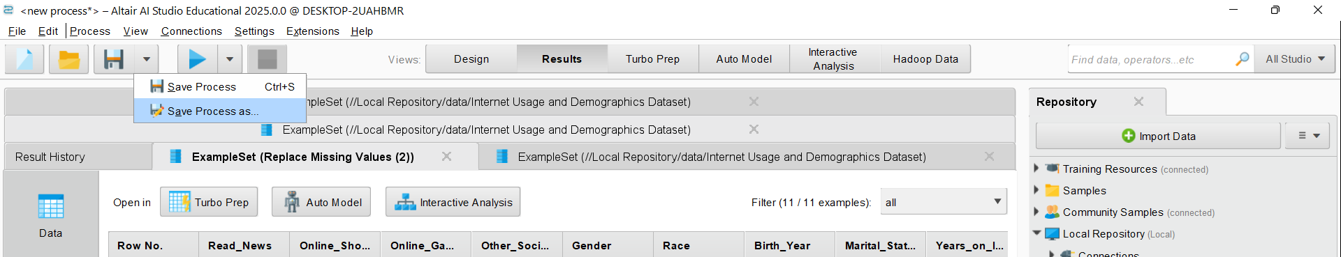
Step 7) Save the Cleaned Dataset in RapidMiner
Go to the "Results" Tab (which you are already in).
Click on the Save Icon (Disk icon at the top of the Results tab).
Click on Save Process As
Choose the Save Location:
In the Repository panel, go to Local Repository → data.
Click "Save As" and enter a new name (e.g., Cleaned_Internet_Usage_Dataset).
Make sure the file format is .csv or another preferred format.

Slide 48
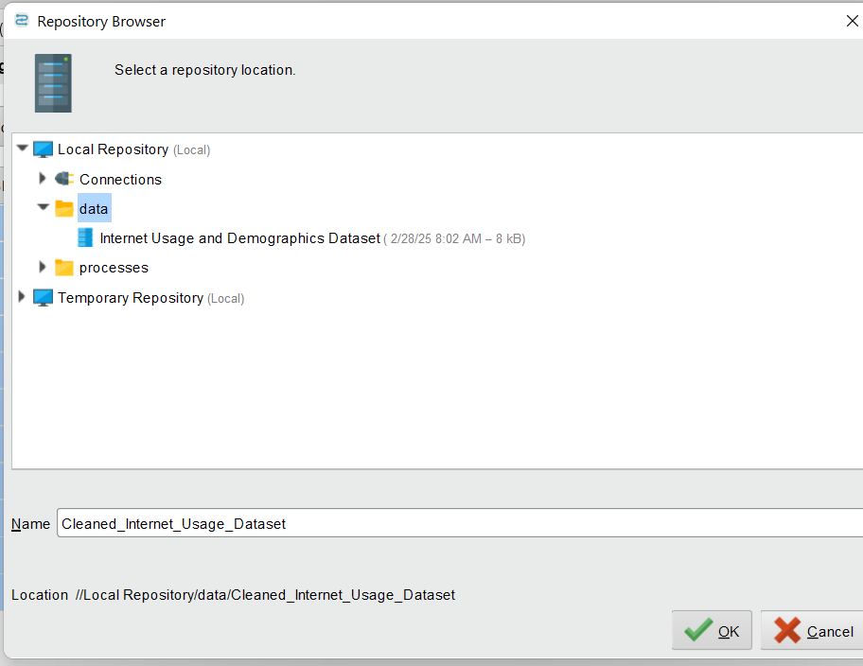
Step 7) Save the Cleaned Dataset in RapidMiner
Go to the "Results" Tab (which you are already in).
Click on the Save Icon (Disk icon at the top of the Results tab).
Click on Save Process As
Choose the Save Location:
In the Repository panel, go to Local Repository → data.
Click "Save As" and enter a new name (e.g., Cleaned_Internet_Usage_Dataset).
Make sure the file format is .csv or another preferred format.

Slide 49
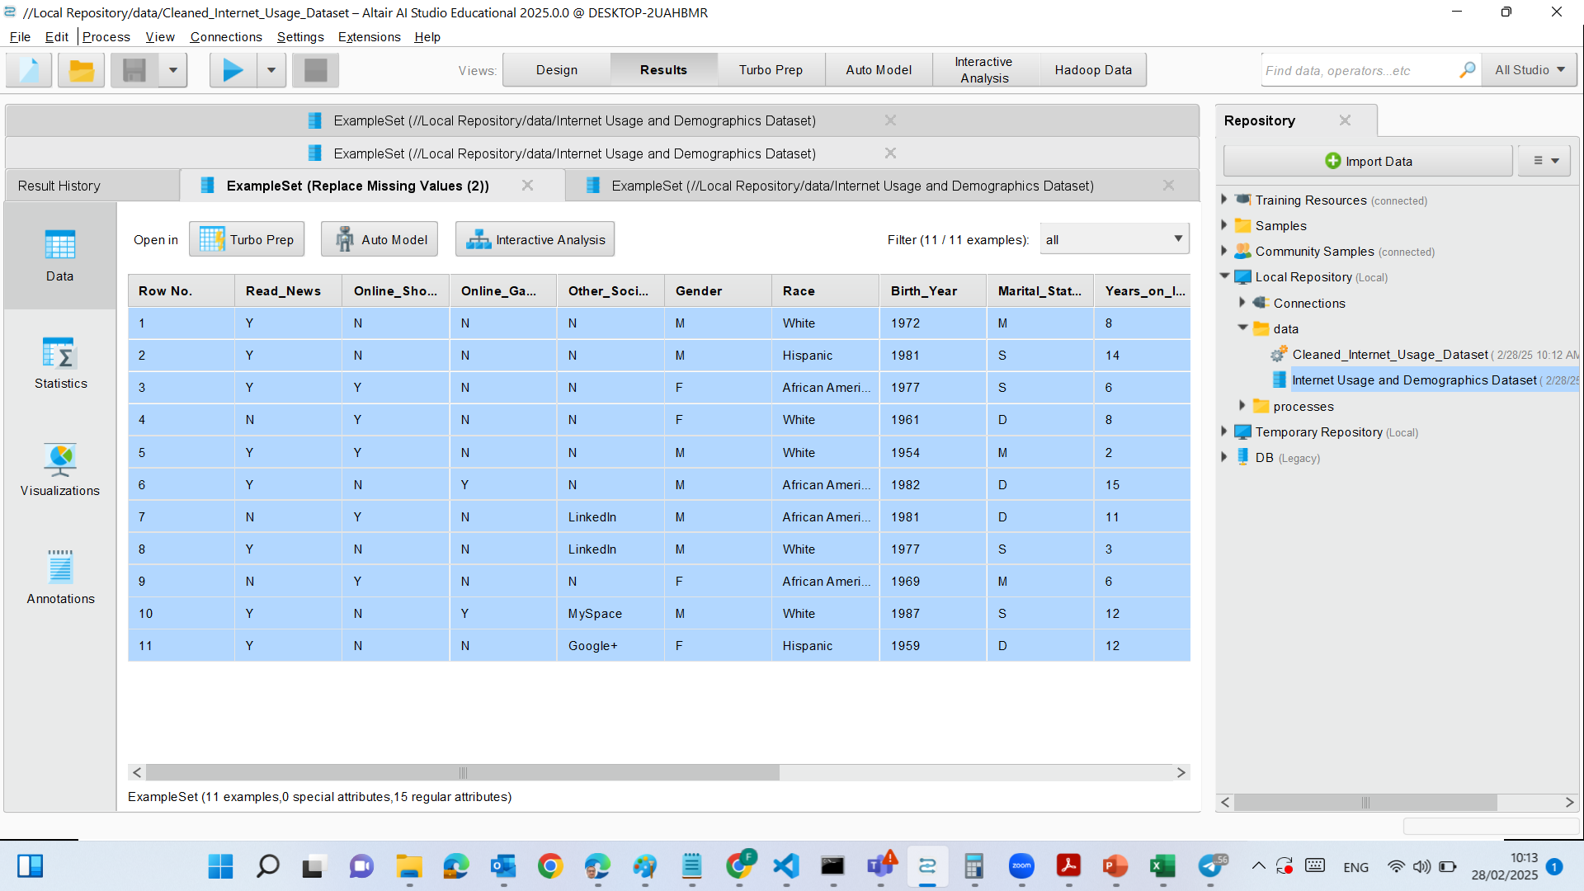
Step 7) Save the Cleaned Dataset in RapidMiner

Slide 50
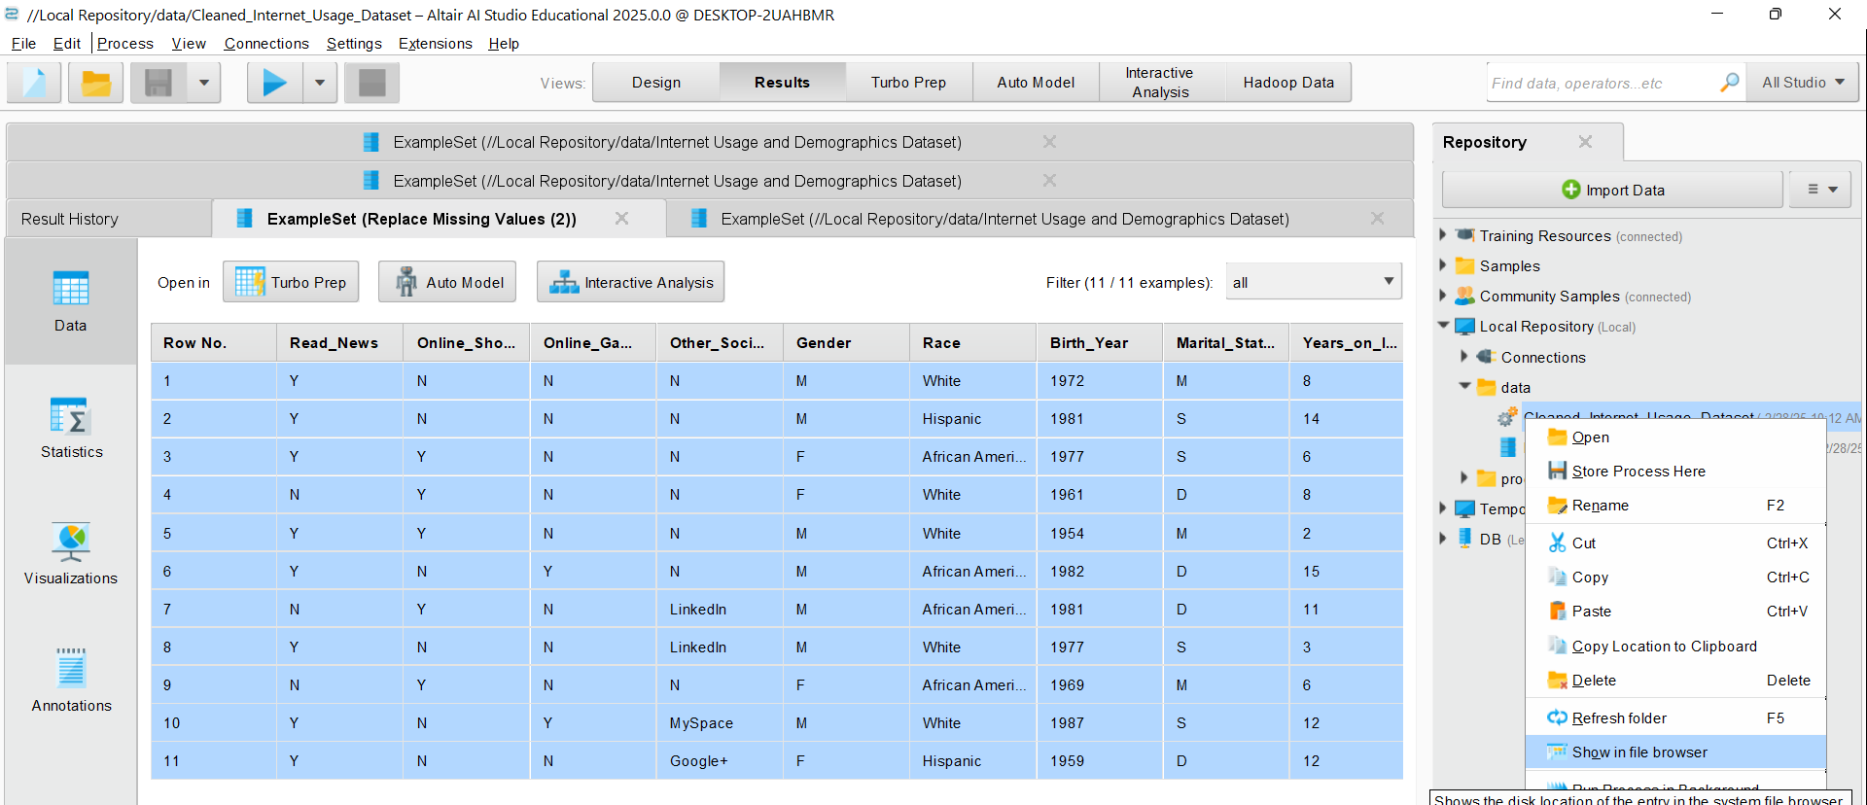
See data in file browser

Slide 51
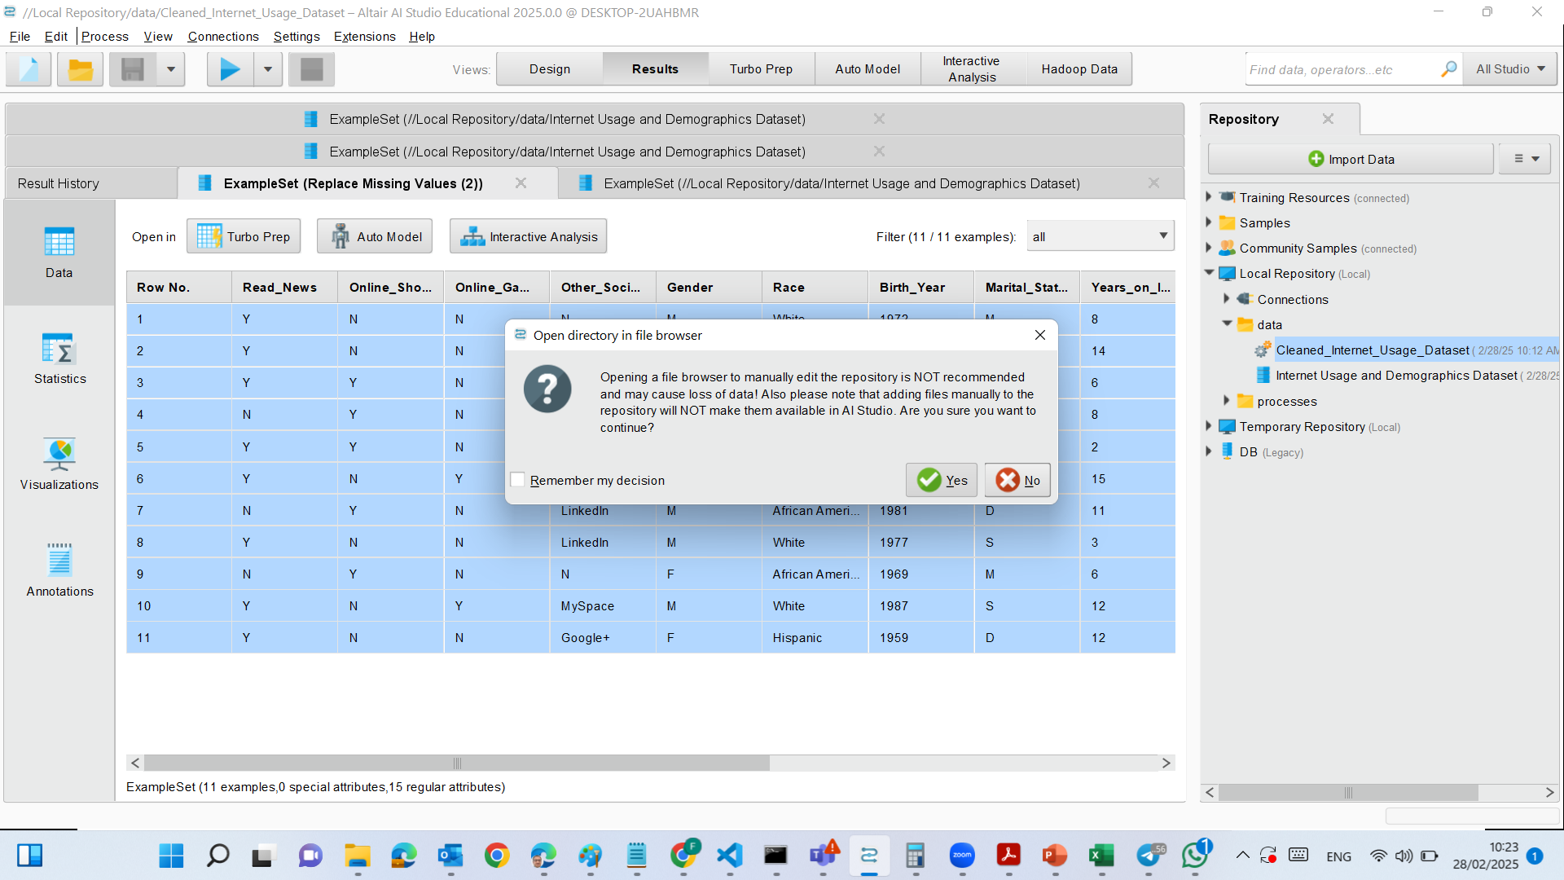
See data in file browser

Slide 52
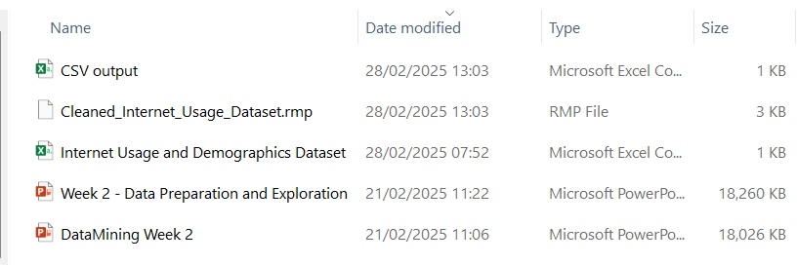
See data in file browser

Slide 53
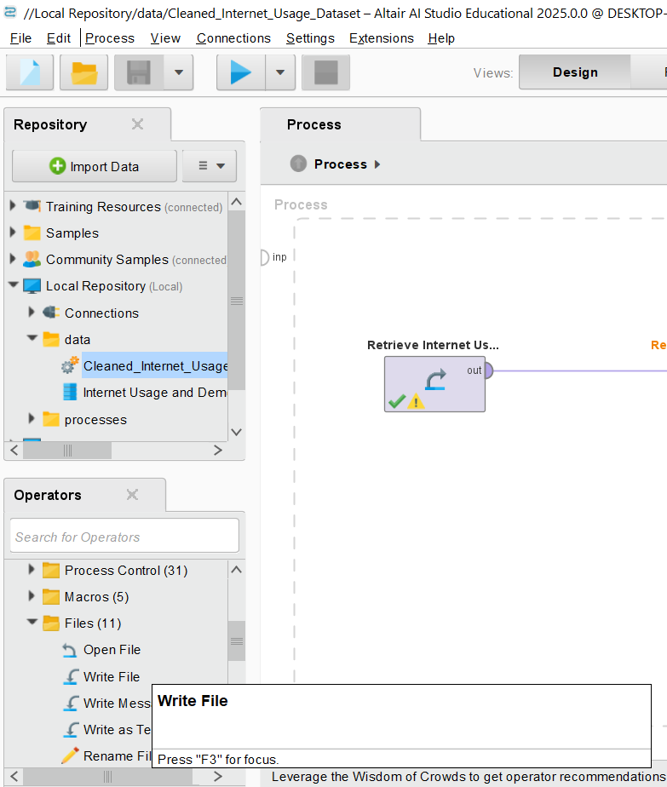
Export as a CSV File
If we want to export the dataset for external use (e.g., Excel, Python, SQL, etc.), we should follow these steps:
Go to "Processes" View (Design mode).
Search for "Write CSV" Operator (under Operators → Data Access → Write CSV).
Drag the "Write CSV" Operator into the process window.

Slide 54
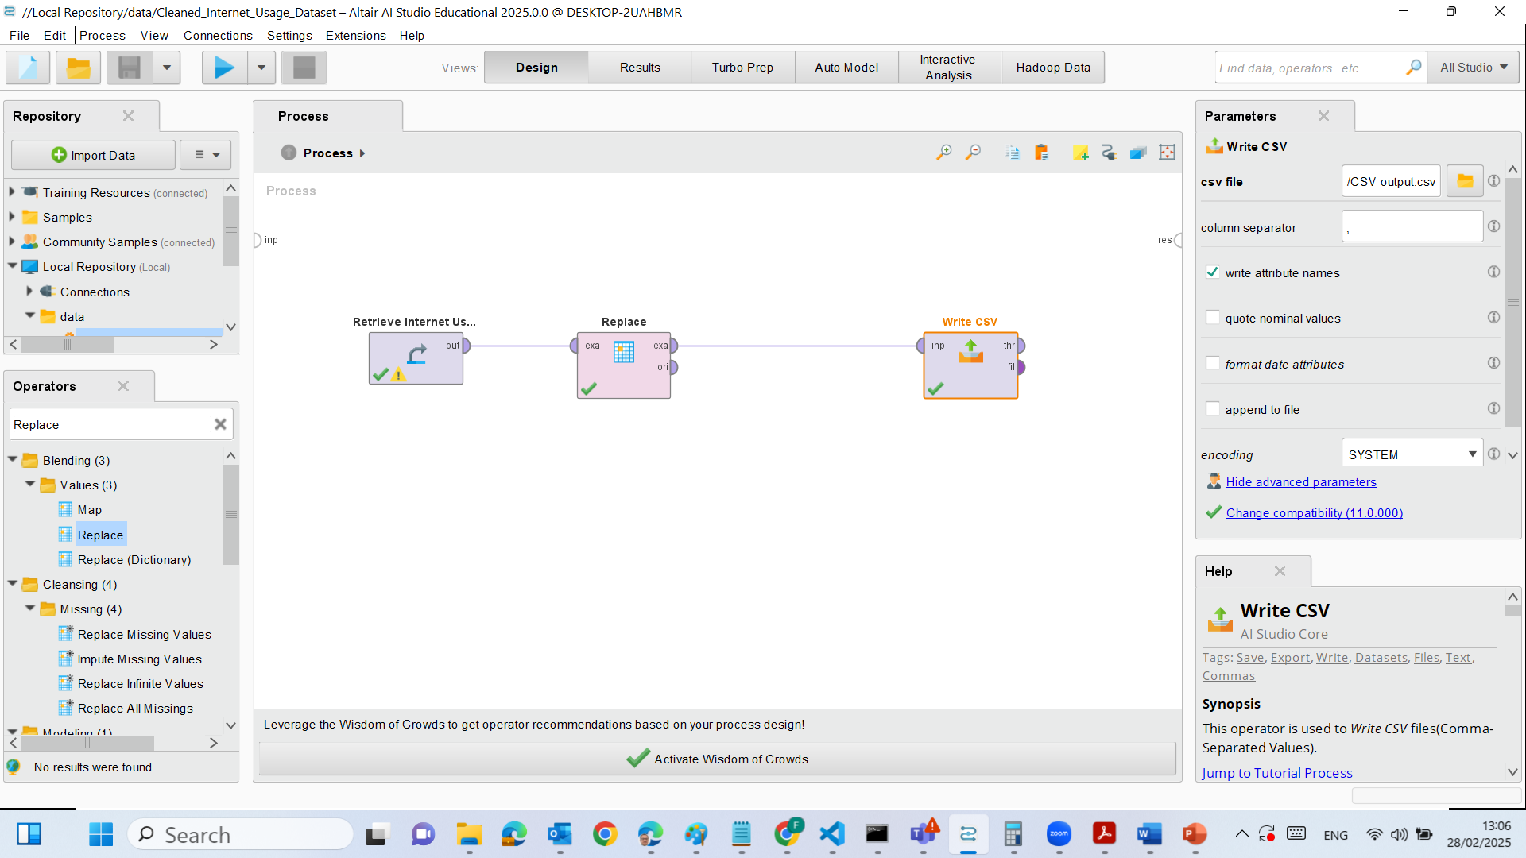
Connect it:
Replace Missing Values output ("exa") → Write CSV input ("inp").

Slide 55
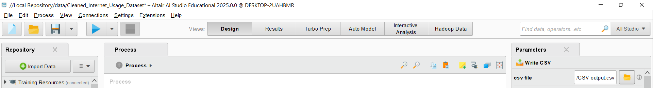
Set Parameters:
In the Parameters panel, choose a location (e.g., C:\Users\YourName\Documents\Cleaned_Internet_Usage.csv).

Slide 56
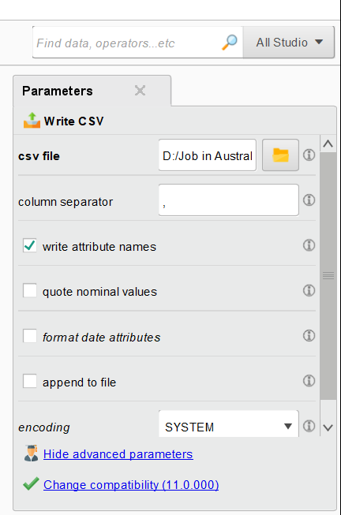
Set Parameters:
Enable Writing Attribute Names:
Ensure "write attribute names" is checked.
Avoid Extra Quotes on Text Fields:
Uncheck "quote nominal values" unless necessary.
Check Formatting of Date Attributes:
Disable "format date attributes" unless you need it.

Slide 57
Run the Process and Check the Saved File
Click on Blue Run button

Slide 58
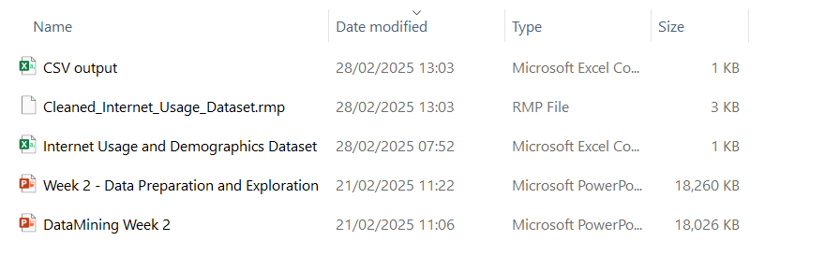
Run the Process and Check the Saved File
Click on Blue Run button

Slide 59
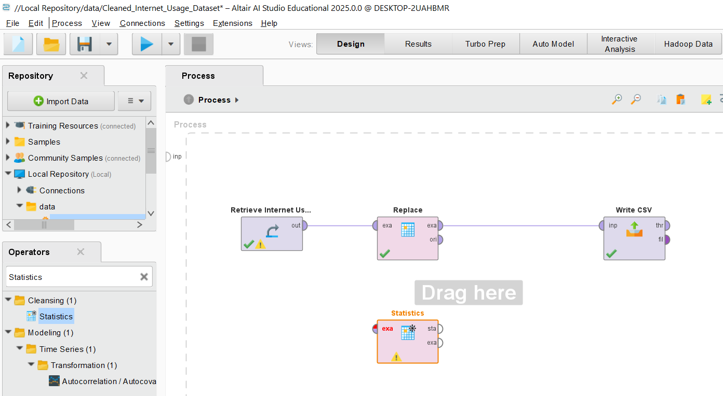
Step 8) Generate Summary Statistics to Verify Data Correctness
Locate the “Statistics” Operator
In the Operators panel (left side), use the search bar and type "Statistics".
Under the Cleansing category, locate the Statistics operator.
Drag and drop the Statistics operator into the Process workspace.

Slide 60
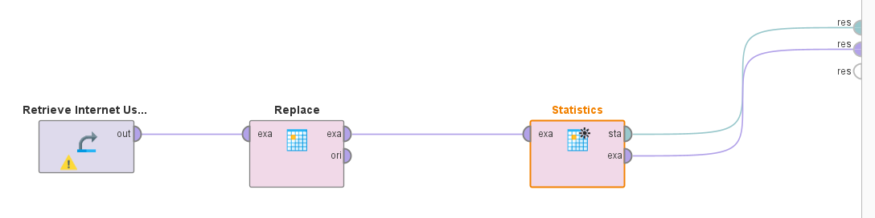
Step 8) Generate Summary Statistics to Verify Data Correctness
Connect the Statistics Operator
Disconnect the Write CSV temporarily.
Connect the output (exa) of the Replace operator to the input (exa) of the Statistics operator.
The output (res) of the Statistics operator should be connected to res (right side)

Slide 61
Step 8) Generate Summary Statistics to Verify Data Correctness
No specific configurations are needed
We need to verify that:
All numerical and categorical attributes are included.
Ensure that the Twitter column (or any replaced values) is included.

Slide 62
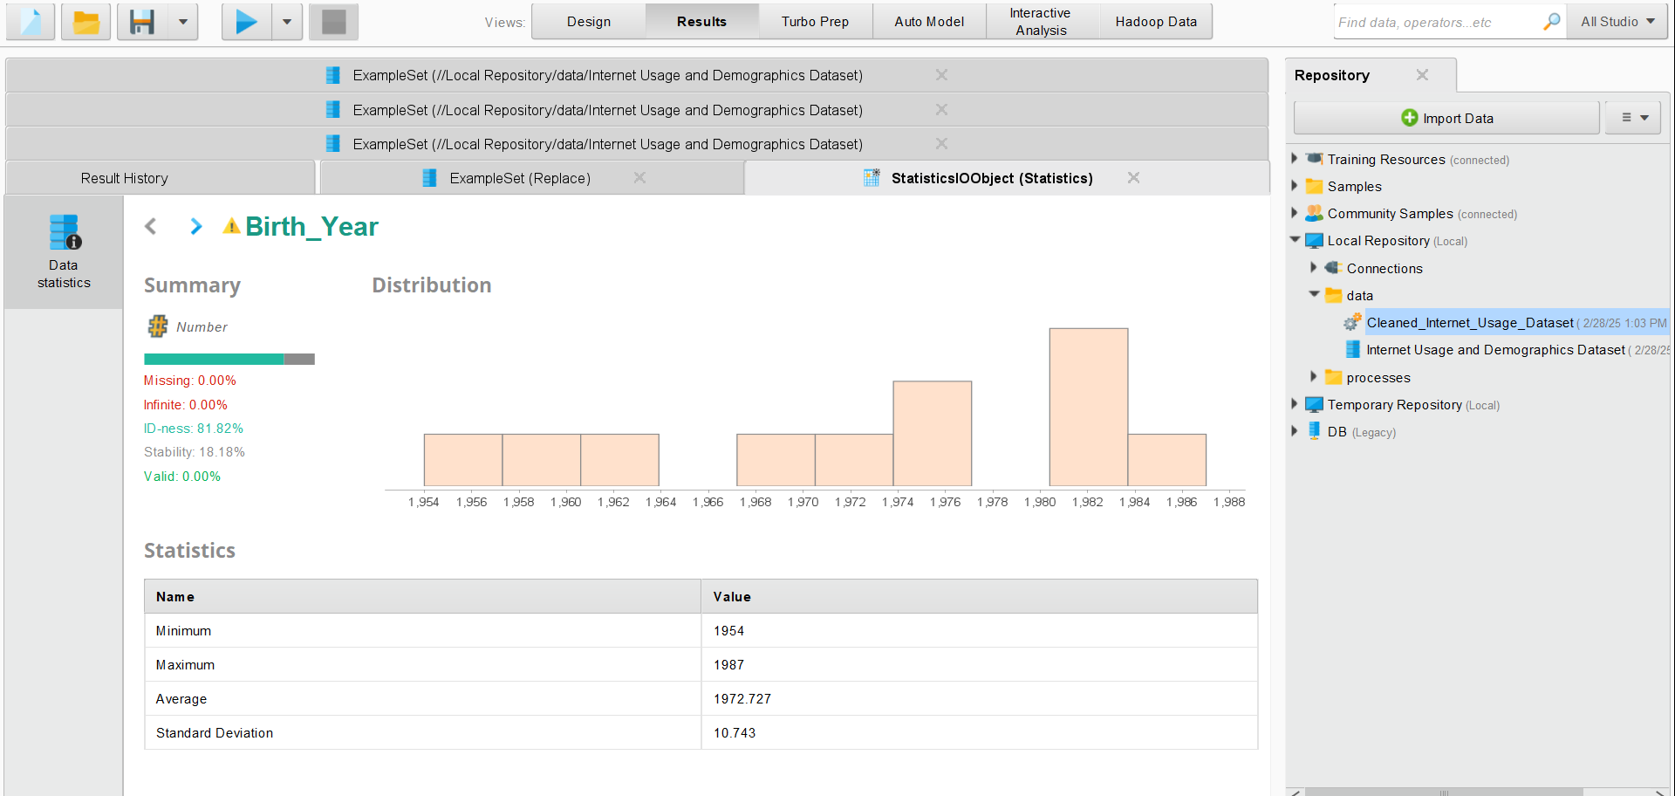
Step 8) Generate Summary Statistics to Verify Data Correctness
Run the Process
Click the Run (▶️) button at the top.
Once completed, go to the Results tab and Select Statistics.
The summary statistics will be displayed, showing:
Mean, Median, Min, Max for numerical columns.
Unique values, Mode for categorical columns.
Count of missing values (if any remain).

Slide 63
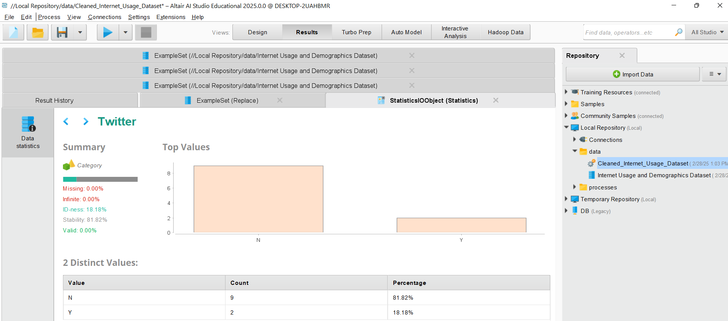
Select ‘Twitter’ to Verify Data Correctness
Check if the 99 values in the Twitter column were successfully replaced with "N".
Ensure no unexpected missing values are present.
Verify if the data distributions match expectations.

Slide 64

Analysis of ‘Birth_Year’
The minimum birth year is 1954, and the maximum is 1987.
The mean birth year is ~1972, meaning the dataset likely contains middle-aged individuals.
The standard deviation is 10.743, indicating a reasonable spread of ages.

Slide 65
Histogram (Distribution of Birth Years):
The histogram shows grouped bins of birth years.
There is a peak between 1975 and 1982, meaning most individuals in this dataset were born in that range.
Fewer individuals were born before 1960 or after 1985, suggesting an older demographic.

Slide 66
Most individuals fall in the 1975–1982 range.
No missing or infinite values, making this a clean dataset for analysis.
High uniqueness (ID-ness), meaning this column is not ideal for categorical grouping.
The dataset likely represents a middle-aged population.

Slide 67
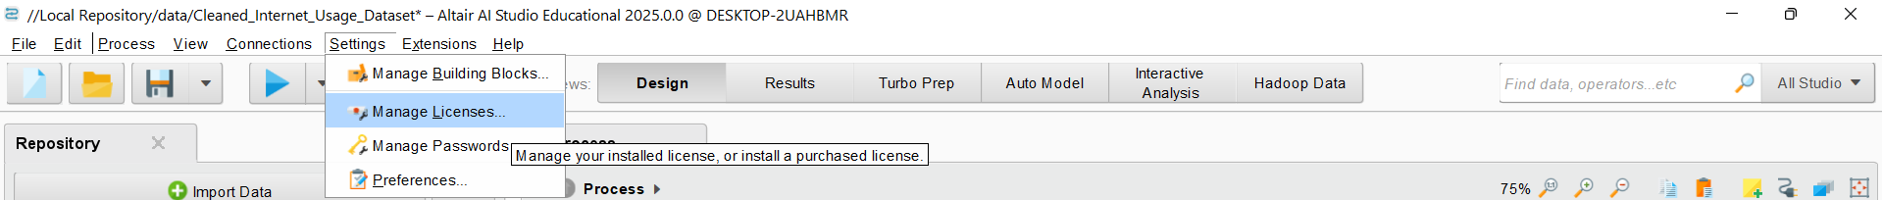
Manage Licenses

Slide 68
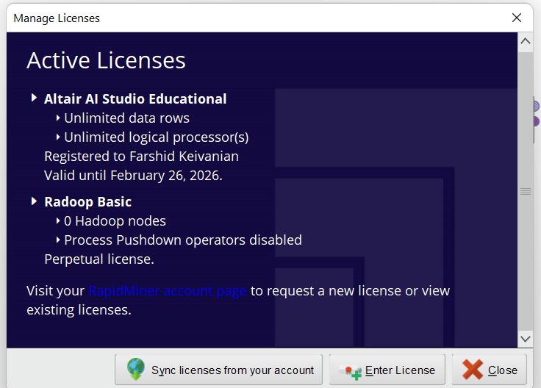
Manage Licenses

Slide 69
Thank You
Have a Great Learning Day!
Feel free to reach out with any questions!

